Slide 1
Why the world is not flat?
--historical view to explore the causes of the nonuniform development between areas

Slide 2



Slide 3
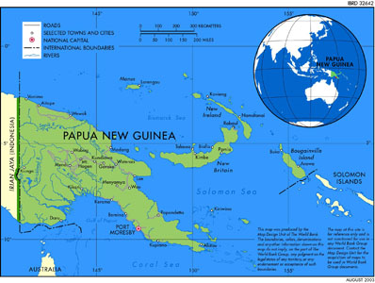
Yali’s Question
Why is it that you white people developed so much cargo and brought it to New Guinea, but we black people had little cargo of our own?

Slide 4

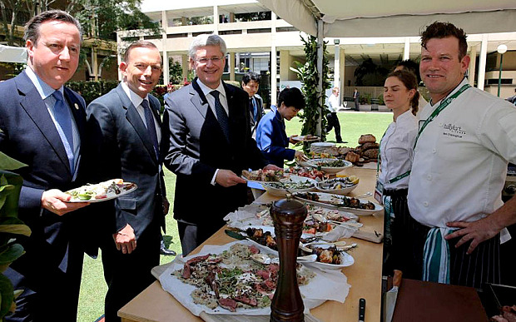
Yari’s Question
Why is it that you white people developed so much cargo and brought it to New Guinea, but we black people had little cargo of our own?

Slide 5


Yari’s Question
Why is it that you white people developed so much cargo and brought it to New Guinea, but we black people had little cargo of our own?

Slide 6
Wrong point I: Social Darwinism
Are Europeans genetically more intelligent than Africans?
1)Cognitive ability heavily influenced by the social environment.
2) From author’s experience, New Guineans are smarter than Europeans.
3) Modern “Stone Age” peoples are on the average probably more intelligent, not less intelligent than industrialized peoples.

Slide 7
Wrong point II: North More Advanced
Are people coming from north technically more advanced than people in south?
No. North Europeans contributes little to civilization until recent thousand of years.

Slide 8
SO WHY?
One sentence answer:
History followed different courses for difference peoples because of differences among peoples’ environments, not because of biological differences among peoples themselves.

Slide 9
SO WHY?

Slide 10
Potato Wars: A small scaled human history
Wars among New Zealand’s indigenous Maori people, between 1818 and the 1830s----wars by which European guns spread among tribes that had previously fought one another with stone and wooden weapons.

Slide 11
From the Beginning of Human History

Slide 12
The rise and spread of food production
Farmers VS hunter-gatherers:
Farmer Power:
More food through domestic animals and plants means more people
Sedentary lifestyle enforced by food production: higher birth rate, store food surplus
Food surplus enables political organizations, specialists, art, war…
Denser mammals and people bring more germs

Slide 13
Centers of origin of food production

Slide 14
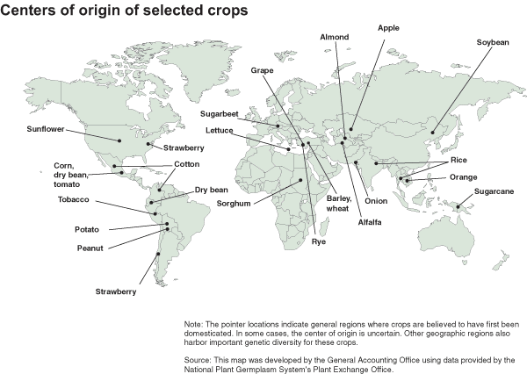

Slide 15
Centers of origin of food production

Slide 17
Spacious Skies and Tilted Axes

Slide 18
From Food to Guns, Germs, and Steel

Slide 19
From Food to Guns, Germs, and Steel
Necessity is the mother of invention
Wheels invented in Eurasia, but not in America which lacks big mammals for transportation

Slide 22
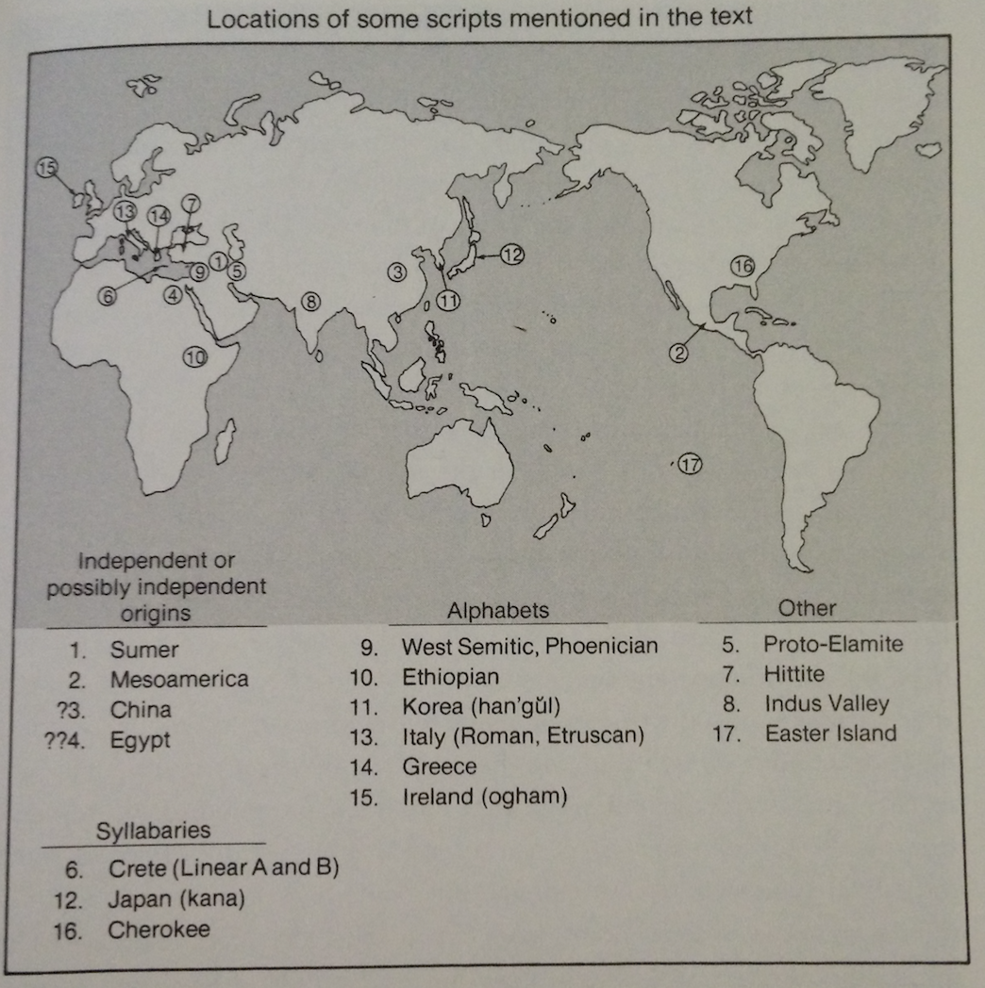
From Food to Guns, Germs, and Steel

Slide 23
From Food to Guns, Germs, and Steel

Slide 24
From Food to Guns, Germs, and Steel

Slide 25
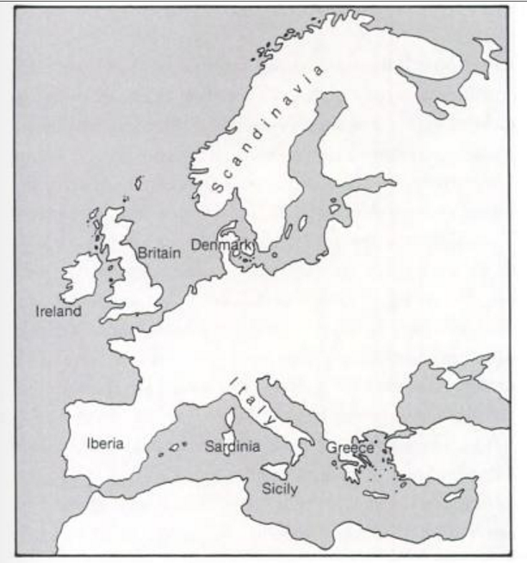
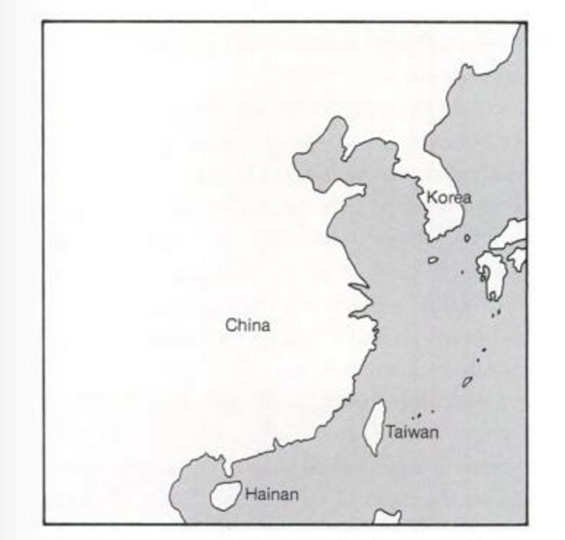
Discussions:
Why Europeans not Fertile Crescents or Chinese?

